Slide 1
Statistical Reasoning Examples
Artificial Intelligence

Slide 2
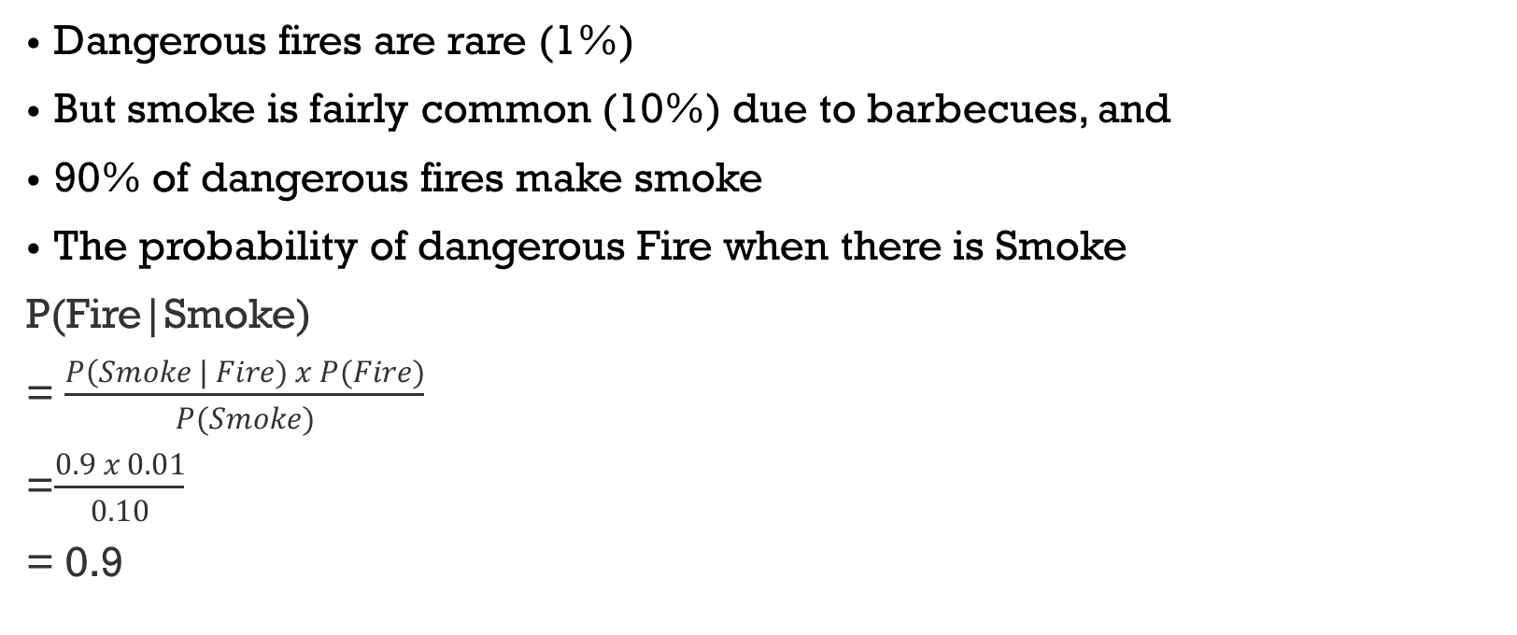
Practice Problem 1
Dangerous fires are rare (1%)
But smoke is fairly common (10%) due to barbecues, and
90% of dangerous fires make smoke
The probability of dangerous Fire when there is Smoke
P(Fire|Smoke)
= $\frac{P\left(Smoke \right| Fire) x P(Fire)}{P(Smoke)}$
=$\frac{0.9 x 0.01}{0.10}$
= 0.9
Notes:
https://www.mathsisfun.com/data/bayes-theorem.html

Slide 3
Practice Problem 2
You are planning a picnic today, but the morning is cloudy.
Oh no! 50% of all rainy days start off cloudy!
But cloudy mornings are common (about 40% of days start cloudy)
And this is usually a dry month (only 3 of 30 days tend to be rainy, or 10%)
What is the chance of rain during the day if it’s a cloudy day?
Answer: 0.125 or 12.5%
Notes:
https://www.mathsisfun.com/data/bayes-theorem.html

Slide 4
Practice Problem 3
In Mr. Symons' class, if a student does homework most days, the chance of passing the course is 90%. On the other hand, if a student does not do homework most days, the chance of passing the course is only 20%.
H = event that the student did homework
C = event that the student passed the course
Mr. Symons claims that 80% of his students do homework on a regular basis. If a student is chosen at random from Mr. Symons' class, find the following probabilities.
P(C)
P(H|C)
Notes:
Problem: https://math.libretexts.org/Bookshelves/Applied_Mathematics/Applied_Finite_Mathematics_(Sekhon_and_Bloom)/09%3A_More_Probability/9.02%3A_Bayes'_Formula/9.2.01%3A_Bayes'_Formula_(Exercises)
Solution: https://www.gauthmath.com/solution/1804158154263557/In-Mr-Symons-class-if-a-person-does-his-homework-most-days-his-chance-of-passing
P(H) = 0.8
P(C|H) = 0.9
P(C|H’) = 0.2
P(C) = P(C|H)P(H) + P(C|H’)P(H’) = 0.9*0.8 + 0.2*0.2 = 0.76
P(H|C) = P(C|H)P(H) / P(C) = 0.9*0.8 / 0.76 = 0.947
P(C|H) = P(H|C)P(C) / P(H) =

Slide 5
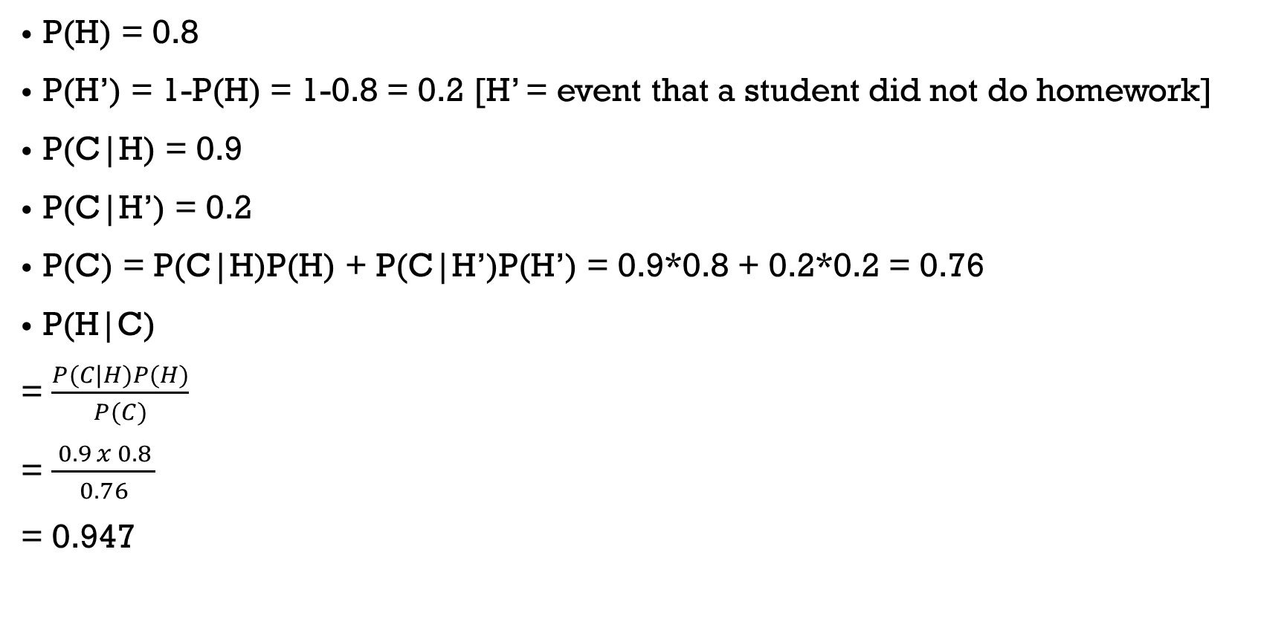
Practice Problem 3
P(H) = 0.8
P(H’) = 1-P(H) = 1-0.8 = 0.2 [H’ = event that a student did not do homework]
P(C|H) = 0.9
P(C|H’) = 0.2
P(C) = P(C|H)P(H) + P(C|H’)P(H’) = 0.9*0.8 + 0.2*0.2 = 0.76
P(H|C)
= $\frac{P(C|H)P(H)}{P(C)}$
= $\frac{ 0.9 x 0.8 }{0.76}$
= 0.947
Notes:
Problem: https://math.libretexts.org/Bookshelves/Applied_Mathematics/Applied_Finite_Mathematics_(Sekhon_and_Bloom)/09%3A_More_Probability/9.02%3A_Bayes'_Formula/9.2.01%3A_Bayes'_Formula_(Exercises)
Solution: https://www.gauthmath.com/solution/1804158154263557/In-Mr-Symons-class-if-a-person-does-his-homework-most-days-his-chance-of-passing
P(H) = 0.8
P(C|H) = 0.9
P(C|H’) = 0.2
P(C) = P(C|H)P(H) + P(C|H’)P(H’) = 0.9*0.8 + 0.2*0.2 = 0.76
P(H|C) = P(C|H)P(H) / P(C) = 0.9*0.8 / 0.76 = 0.947
P(C|H) = P(H|C)P(C) / P(H) =

Slide 6
Practice Problem 4
A test for a certain disease gives a positive result 95% of the time if the person actually carries the disease. However, the test also gives a positive result 3% of the time when the individual is not carrying the disease. It is known that 10% of the population carries the disease.
D = the event that a person has the disease
TP = the event that a person tests positive
If a person tests positive, what is the probability that he or she has the disease?
Notes:
Problem: https://math.libretexts.org/Bookshelves/Applied_Mathematics/Applied_Finite_Mathematics_(Sekhon_and_Bloom)/09%3A_More_Probability/9.02%3A_Bayes'_Formula/9.2.01%3A_Bayes'_Formula_(Exercises)
Solution: https://www.gauthmath.com/solution/1804158127965189/A-test-for-a-certain-disease-gives-a-positive-test-result-95-of-the-time-if-the-
P(TP|D) = 0.95
P(TP|D’) = 0.03
P(D) = 0.1
P(D’) = 1 – P(D) = 1 – 0.1 = 0.9
P(D|TP) = P(TP|D)P(D) / P(TP) = 0.95*0.1 / 0.122 = 0.779
P(TP) = P(TP|D)P(D) + P(TP|D’)P(D’) = 0.95*0.1 + 0.03*0.9 = 0.122

Slide 7
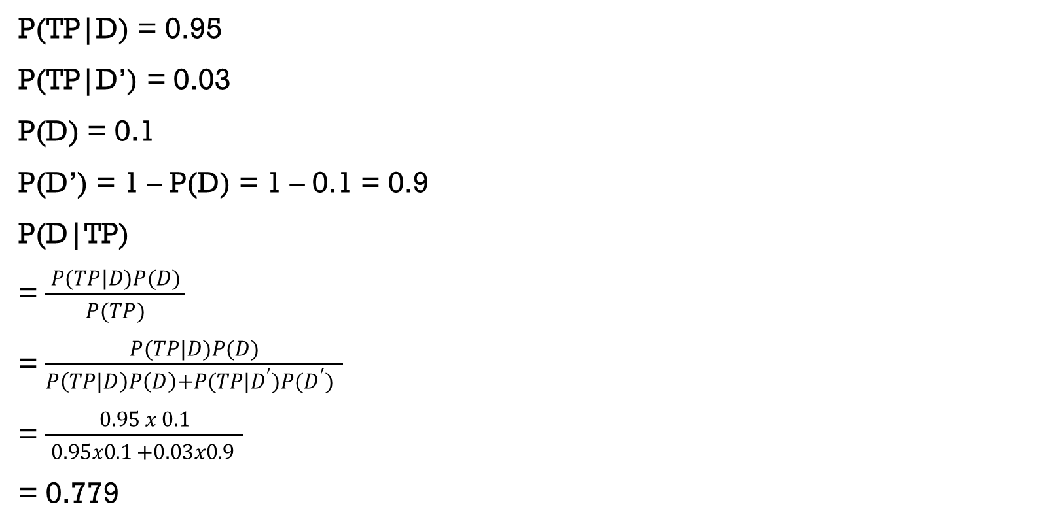
Practice Problem 4
P(TP|D) = 0.95
P(TP|D’) = 0.03
P(D) = 0.1
P(D’) = 1 – P(D) = 1 – 0.1 = 0.9
P(D|TP)
= $\frac{ P(TP|D)P(D) }{P(TP)}$
= $\frac{ P(TP|D)P(D) }{P\left(TP|D\right)P\left(D\right)+P(TP|D^{′})P(D^{′}) }$
= $\frac{ 0.95 x 0.1 }{ 0.95x0.1 +0.03x0.9 }$
= 0.779
Notes:
Problem: https://math.libretexts.org/Bookshelves/Applied_Mathematics/Applied_Finite_Mathematics_(Sekhon_and_Bloom)/09%3A_More_Probability/9.02%3A_Bayes'_Formula/9.2.01%3A_Bayes'_Formula_(Exercises)
Solution: https://www.gauthmath.com/solution/1804158127965189/A-test-for-a-certain-disease-gives-a-positive-test-result-95-of-the-time-if-the-
P(TP|D) = 0.95
P(TP|D’) = 0.03
P(D) = 0.1
P(D’) = 1 – P(D) = 1 – 0.1 = 0.9
P(D|TP) = P(TP|D)P(D) / P(TP) = 0.95*0.1 / 0.122 = 0.779
P(TP) = P(TP|D)P(D) + P(TP|D’)P(D’) = 0.95*0.1 + 0.03*0.9 = 0.122

Slide 8
Practice Problem 5
A person uses his car 30% of the time, walks 30% of the time and rides the bus 40% of the time as he goes to work. He is late 10% of the time when he walks; he is late 3% of the time when he drives; and he is late 7% of the time he takes the bus.
(i) What is the probability he took the bus if he was late?
(ii) What is the probability he walked if he is on time?
Answer: (i) 0.418 and (ii) 0.289
Notes:
https://mathcenter.oxford.emory.edu/site/math117/probSetBayesTheorem/

Slide 9
Practice Problem 6
It is estimated that 50% of emails are spam emails. Some software has been applied to filter these spam emails before they reach your inbox. A certain software brand claims it can detect 99% of spam emails, and the probability of a false positive (a non-spam email detected as spam) is 5%.
A = event that an email is detected as spam,
B = event that an email is spam
Now if an email is detected as spam, then what is the probability that it is in fact a non-spam email?
Answer: 0.048
Notes:
https://www2.math.upenn.edu/~mmerling/math107%20docs/practice%20on%20Bayes%20solutions.pdf

